Slide 1

AWS Security Hub
Presentation by:
S.Suresh
CloudSIKSHA

Slide 2
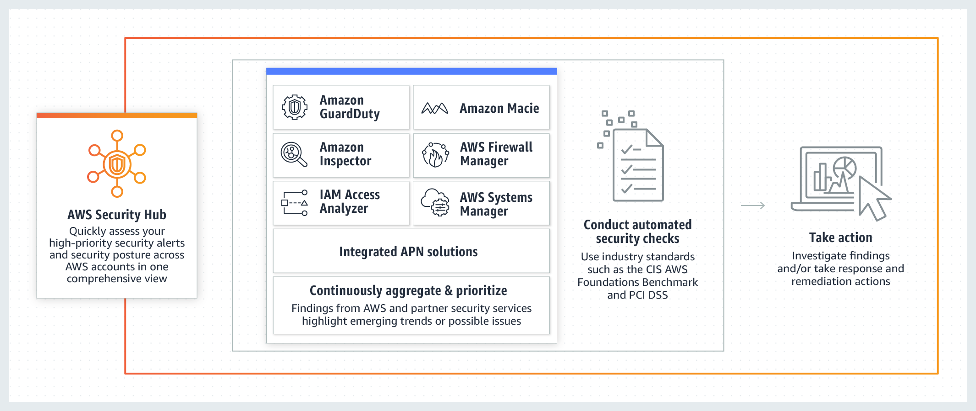
AWS Security Hub

Slide 3

AWS Security Hub Features
Automated, continuous security best practice checks
A set of automated security controls called the AWS Foundational Security Best Practices standard
Consolidated findings across AWS services and partner integrations
A single, standardized data format for all of your findings
AWS Security Findings Format (ASFF)
Security standards aligned to regulatory and industry compliance frameworks
Automated response, remediation, and enrichment actions

Slide 4

Thank you

